Slide 1
TA
1、2
3、4
5、6
16
22
15
21
Blackboard
Robot Hockey Arena
14
19 、 20
7、8
9、10
11、12
13
17 、 18
ICN5406/5058
Floor plan EE632

Slide 2
Checkpoint #3 Obstacle Avoidance
Demo Due : 11/05/2021
Report Due ：11/12/2021

Slide 3
Outline
CP 3 Supplies
Checkpoint #3 Assignment
Hardware Configuration
Introduce to GPIO of Raspberry Pi
Light Sensor and Touch Sensor

Slide 4
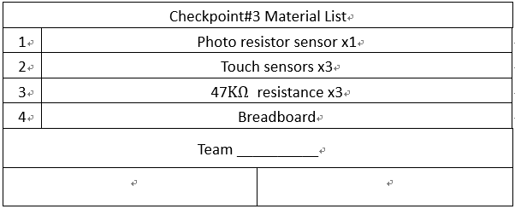
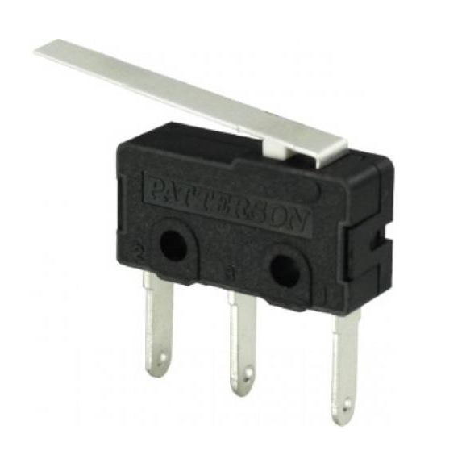
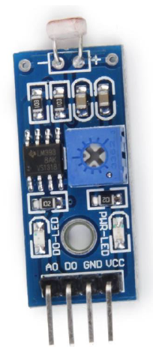
CP 3 Supplies
1
2
NC
NO
COM

Slide 5
Checkpoint #3 Assignment
The purpose of this checkpoint is to make sure you can control your robot to move in the arena. The mobile robot needs to detect an obstacle in front of it and take action to avoid the obstacle in order to continue its motion.
Finally, your robot can find the assigned target. In this checkpoint, the target is a ring of LED lights.

Slide 6
Checkpoint #3 Grading Policy
Please start to arrange the space configuration of your robot, make sure every and each component such as circuit boards and sensors is settled firmly and stable on the chassis and all the robot functions will not be affected by wires.
Make sure that your robot can move freely. It means that you do not need to use keyboard to control it anymore. (30%)
Integrate a light sensor and three touch sensors to the robot and program your robot to find and move toward the LED light. (40%)
The time for you robot to find and touch the LED light (in 90 sec). (30%)

Slide 7
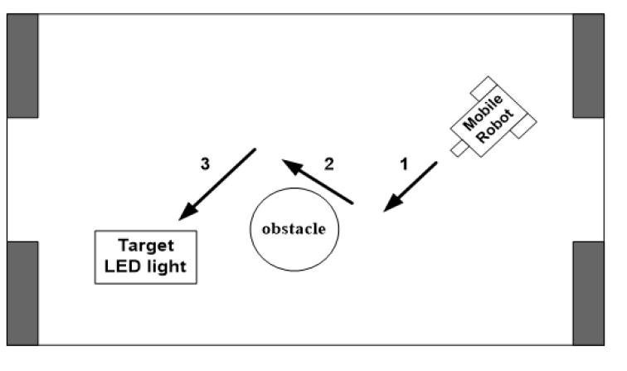
Checkpoint #3

Slide 8
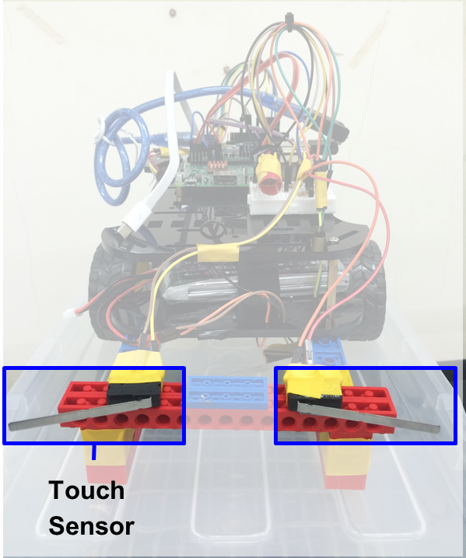
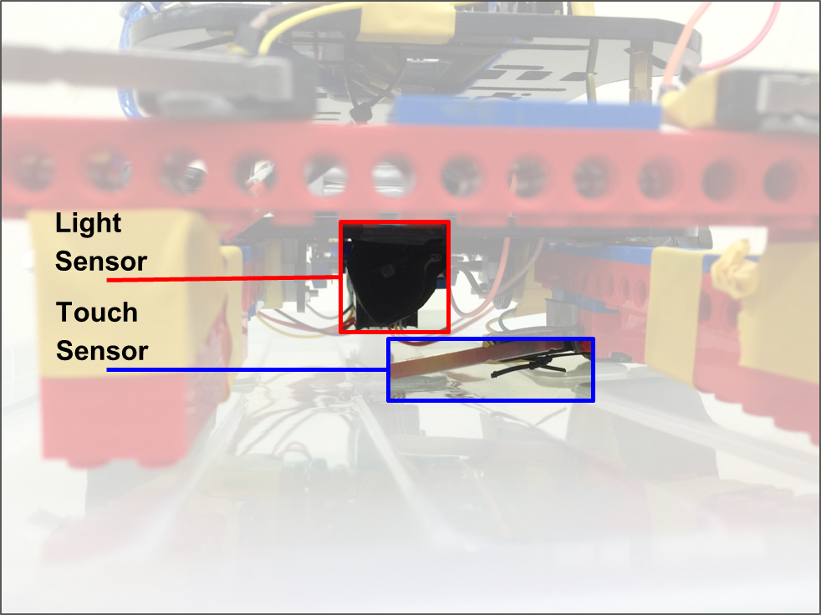
Hardware Configuration

Slide 9
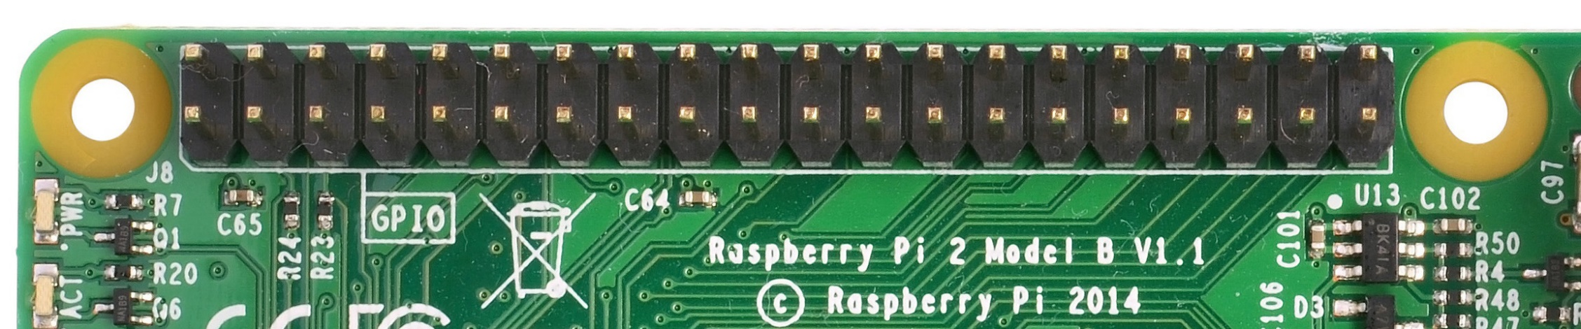
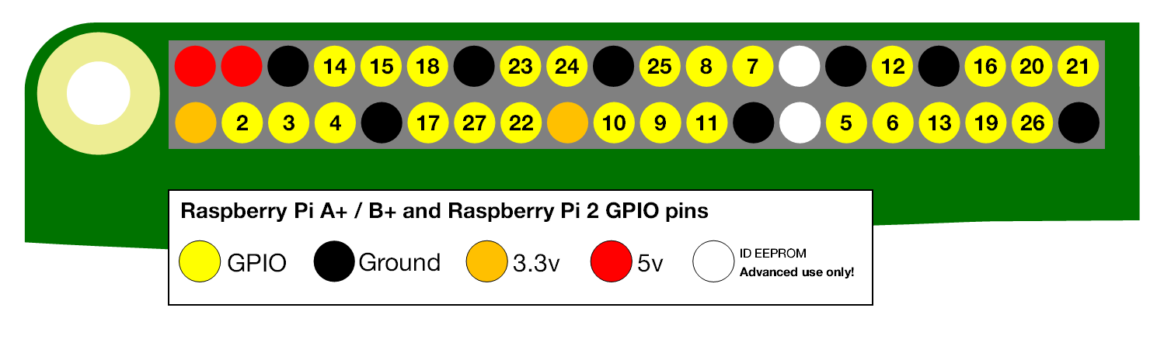
GPIO of Raspberry Pi
GPIO: General-Purpose Input/Output
Notes:
A powerful feature of the Raspberry Pi is the row of GPIO which stands for general-purpose input/output,
The Raspberry Pi has two rows of GPIO pins along the top edge of the board.
Any of the GPIO pins can be designated (in software) as an input or output pin and used for a wide range of purposes.
Output pins are like switches that the Raspberry Pi can turn on or off (like turning on/off a LED light). But it can also send a signal to another device.
Input pins are like switches that you can turn on or off from the outside world (like a on/off light switch). But it can also be a data from a sensor, or a signal from another device.
And other GPIO pins can be used with a variety of alternative functions, some are available on all pins, others on specific pins.
We take PWM signal as example,
Software PWM available on all pins
Hardware PWM available on GPIO12, GPIO13, GPIO18, GPIO19

Slide 10
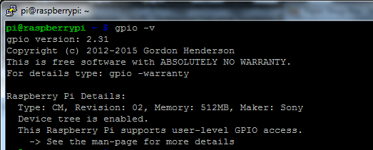
Wiring Pi: GPIO interface library
WiringPi is an attempt to bring Arduino-wiring-like simplicity to the Raspberry Pi.
The goal is to have a single common platform and set of functions for accessing the Raspberry Pi GPIO across multiple languages.
Installation:
C: $ sudo apt-get install wiringpi
$ sudo apt-get install libwiringpi2-dev
Python: $ sudo pip install wiringpi2
Check：
$ gpio -v
Reference: http://wiringpi.com/download-and-install/

Slide 11
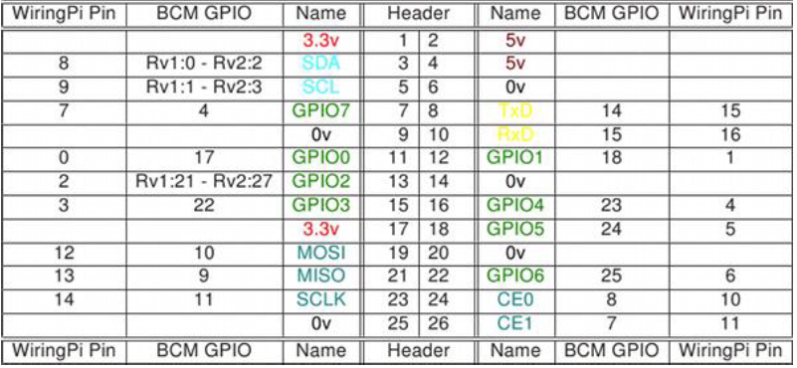
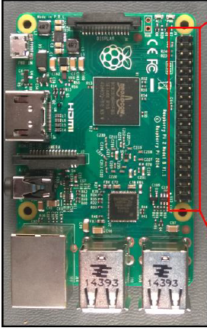
WiringPi’s Pin number
Prints a table of WiringPi’s Pin number on terminal.
$ gpio readall

Slide 12
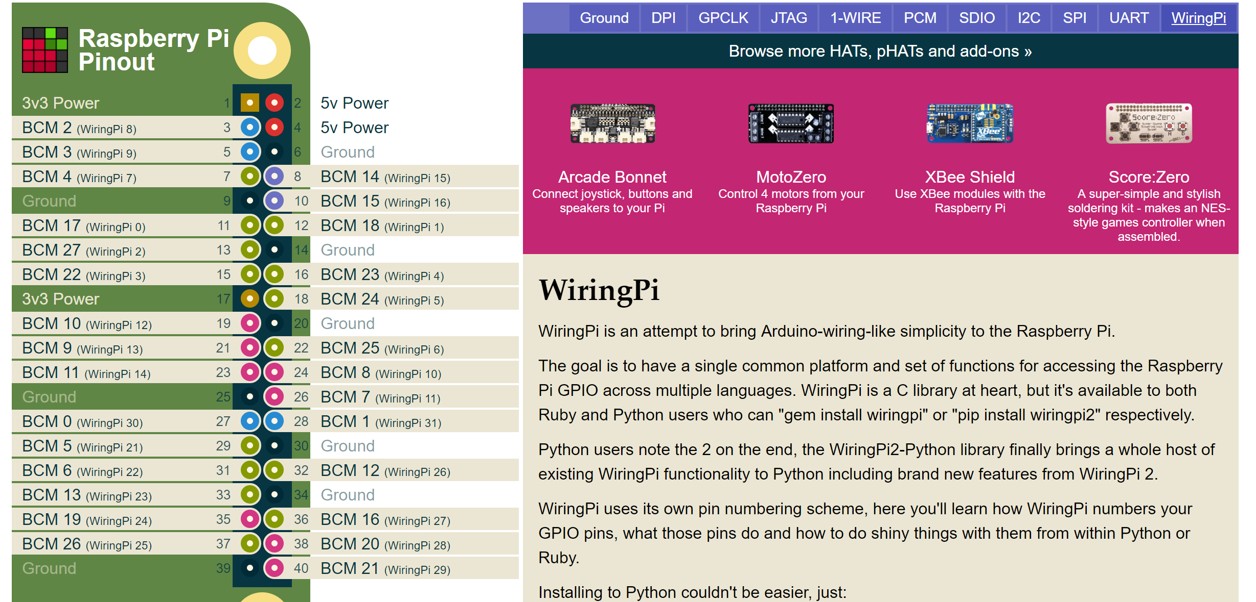
WiringPi’s Pin number
Website Reference: https://pinout.xyz/pinout/wiringpi

Slide 13
Example Code
Sensor‘s pin is connected to Header pin 15 and the WiringPi pin is 3.
Include the Head file
#include <wiringPi.h>
Library setup function.
wiringPiSetup () ;
Setup pin mode
int sensor_pin = 3; //wiringpi’s pin
pinMode (sensor_pin, INPUT) ;
Read pin’s data
sensor_data = digitalRead(sensor_pin) ;

Slide 14
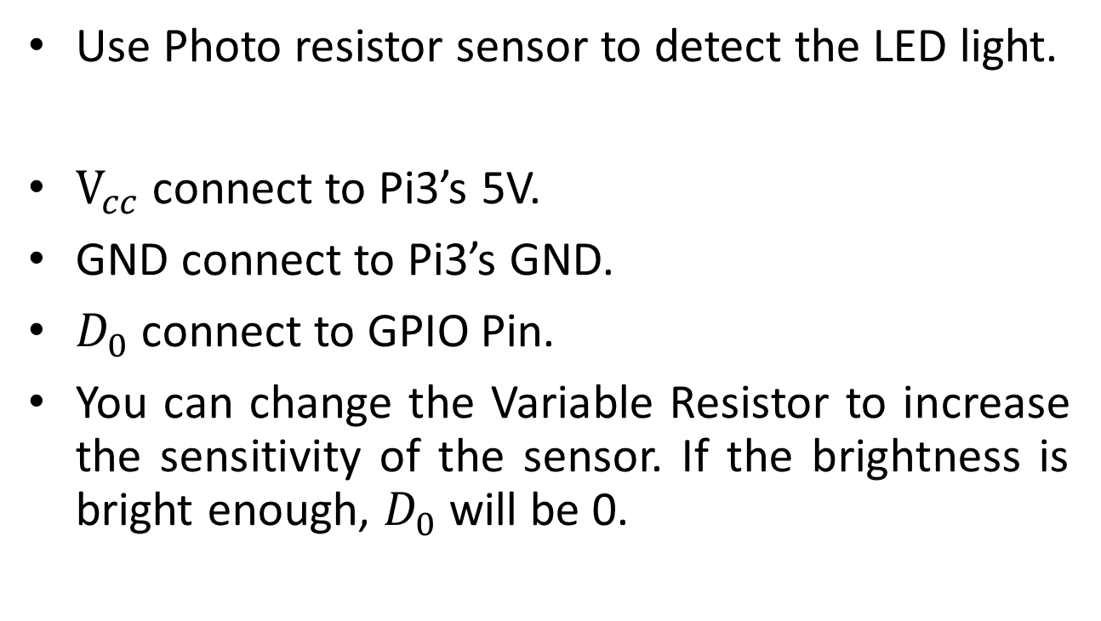
Photo resistor sensor
Use Photo resistor sensor to detect the LED light.
$V_{cc}$ connect to Pi3’s 5V.
GND connect to Pi3’s GND.
$D_{0}$ connect to GPIO Pin.
You can change the Variable Resistor to increase the sensitivity of the sensor. If the brightness is bright enough, $D_{0}$ will be 0.

Slide 15
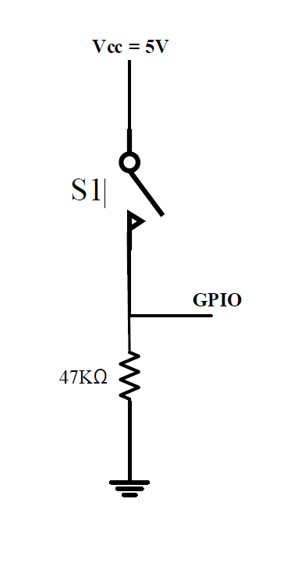
Touch sensor
Integrate touch sensors to avoid an obstacle and walls of the area.
5V
GND
GPIO

Slide 16
Deadline
--------------------------------------------------------
Checkpoint#3 Demo : 11/5
Checkpoint #3 Report : 11/12

Slide 17
CP2 Demo Timetable
Group A 09:30 ~ 10:30 | Group B 10:30 ~ 12:00
Team 12 | Team 1
Team 13 | Team 2
Team 14 | Team 3
Team 15 | Team 4
Team 16 | Team 5
Team 17 | Team 6
Team 18 | Team 7
Team 19 | Team 8
Team 20 | Team 9
Team 21 | Team 10
Team 22 | Team 11

